Slide 1

Stage 3 Accuracy is Accidental Course Designer: Eric Beerbaum & Marcel Englmaier
Accuracy is Accidental is a 58 round, 290 point Comstock course. There are 17 USPSA targets and 12 IPSC targets. The best two hits per paper target will score. The start signal is audible.
The Handgun start position is standing outside the shooting area with heels touching box A. Handgun loaded and holstered OR PCC loaded with safety on, stock on belt, and muzzle pointing down range. Your second firearm is UNLOADED and staged in dump box.
On the audible start signal, engage targets from within the shooting areas. USPSA targets may be engaged with PCC ONLY. IPSC targets may be engaged with Handgun ONLY. Rifle is permitted to swap for PCC in this bay.

Slide 2
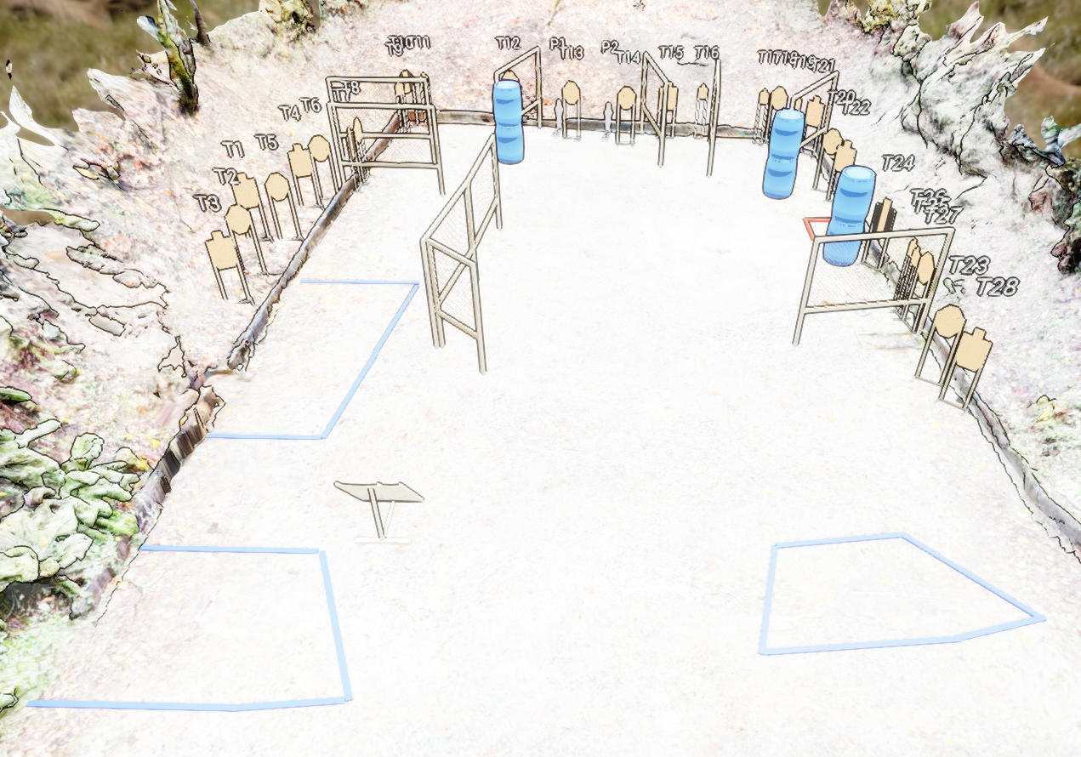
 | Stage 3 Accuracy is Accidental Course Designer: Eric Beerbaum & Marcel Englmaier

